Slide 3
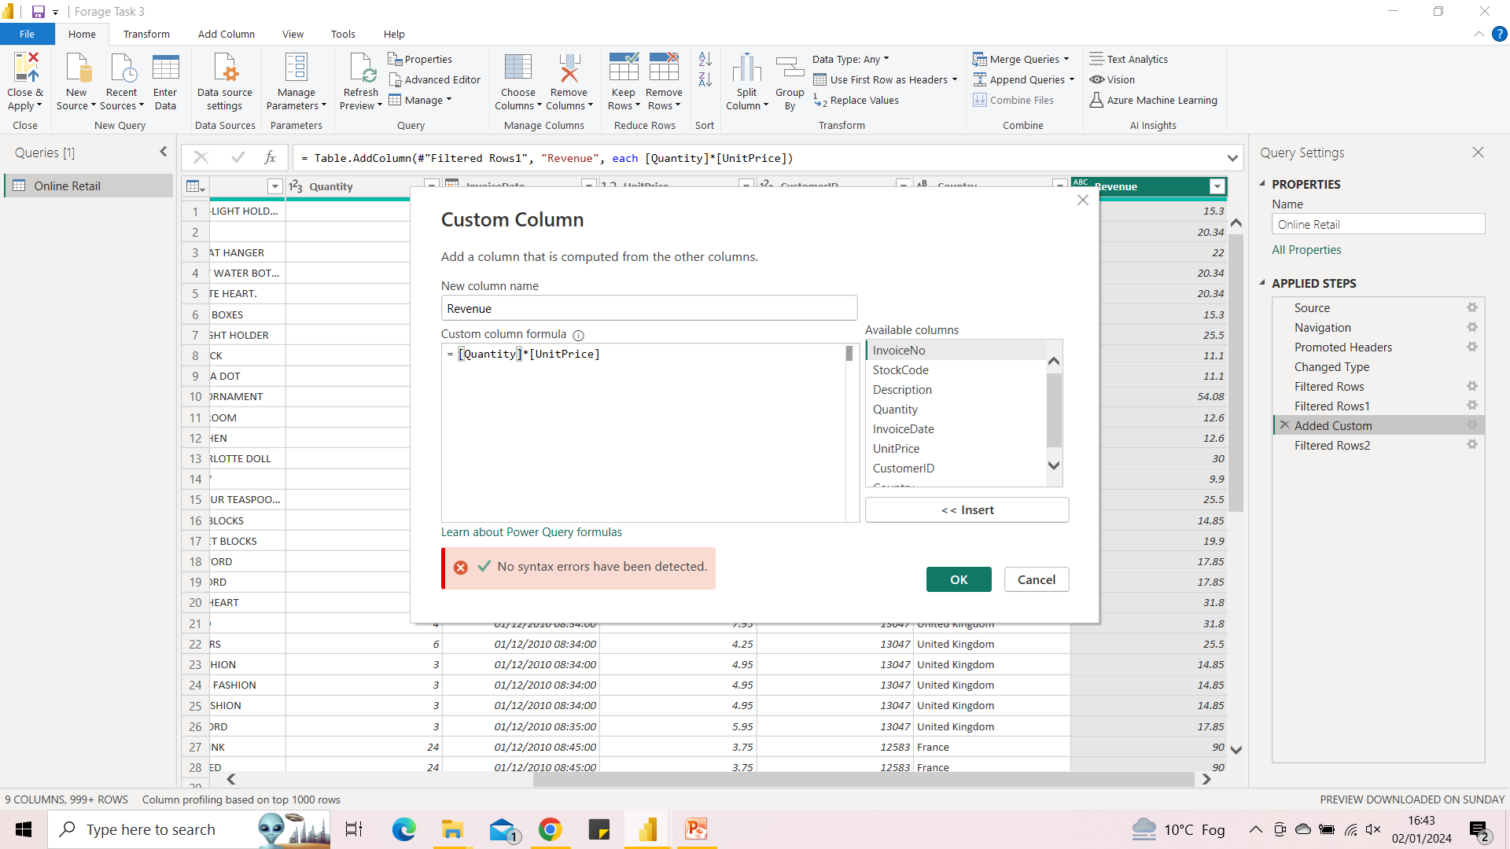
Filtering and Adding Column

Slide 4
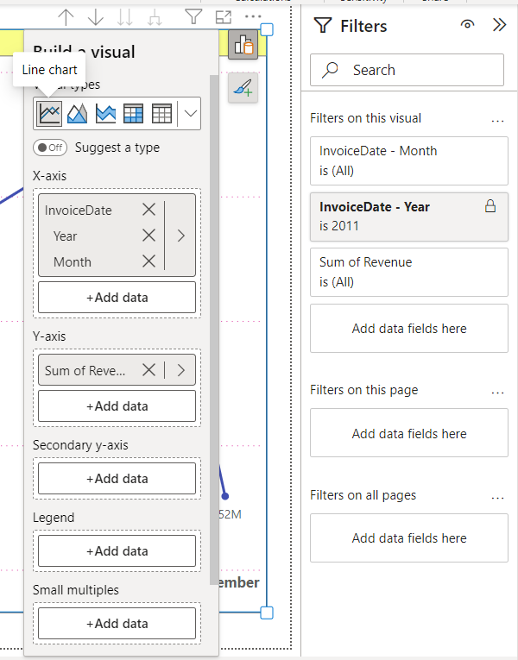
Question 1
Line visual
X-axis-Invoice date
Y-axis-Revenue
Filter
Year -2011

Slide 5
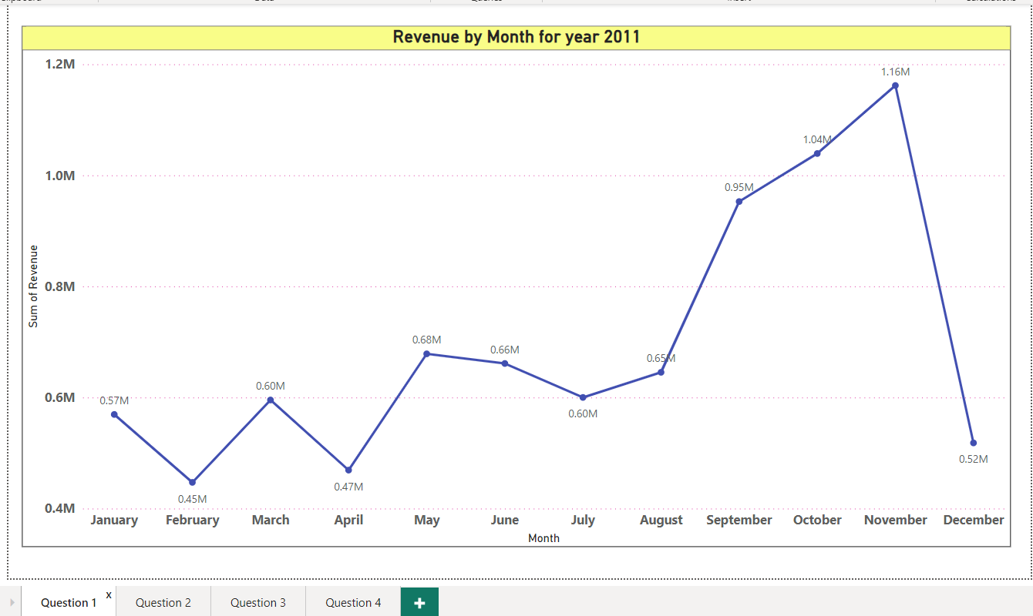
Question 1

Slide 6
Observations – Visual 1
By studying Revenue of year 2011 month by month we can predict next year.
Study of seasonal sale can be predicted.
Month by month Sale will explain need of Stock maintenance.
Some month viz. Feb-April-Dec are at lower site and need more efforts .

Slide 7
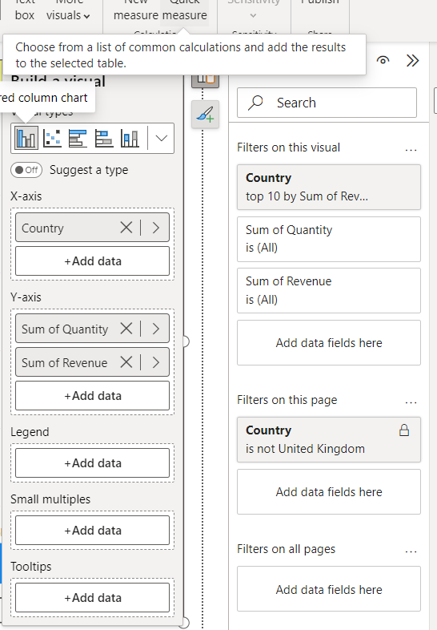
Question 2
Stacked Column visual
X-axis-Country
Y-axis-Revenue
Y-axis-Quantity
Filter
Top 10 Country
Excluding UK

Slide 8
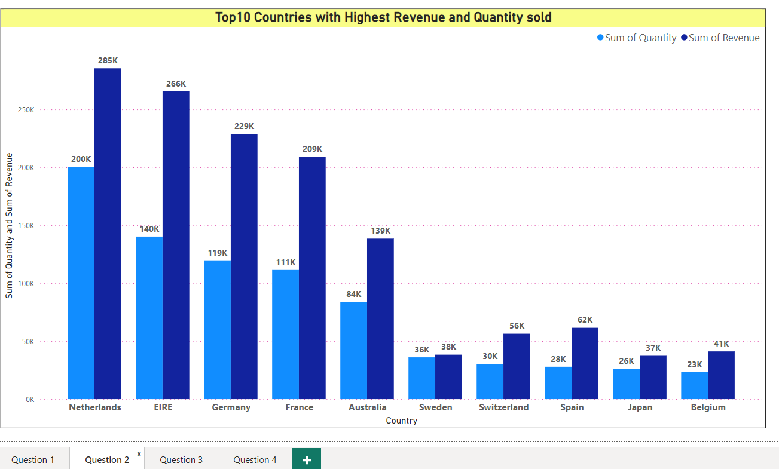
Question 2

Slide 9
Observations - Visual 2
It’s a Quantity-Revenue vs. Country Visual excluding UK.
We can observe Area where business can be expand.
Required Quantity sold to achieve Particular Revenue can be studied with this chart.
This Visual can be further Drill down Product wise, as in Sweden it can be seen the Quantity sold and Revenue are approx. equal.

Slide 10
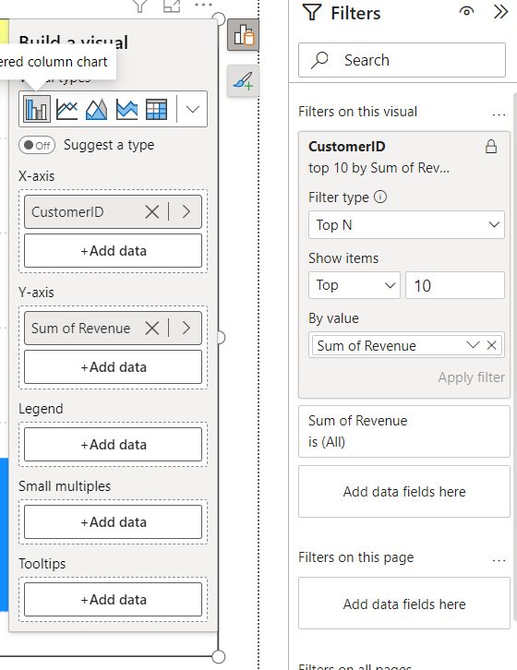
Question 3
Stacked Column visual
X-axis-Customer ID
(Null valued already Filtered)
Y-axis-Revenue
Filter
Top 10 Customers

Slide 11
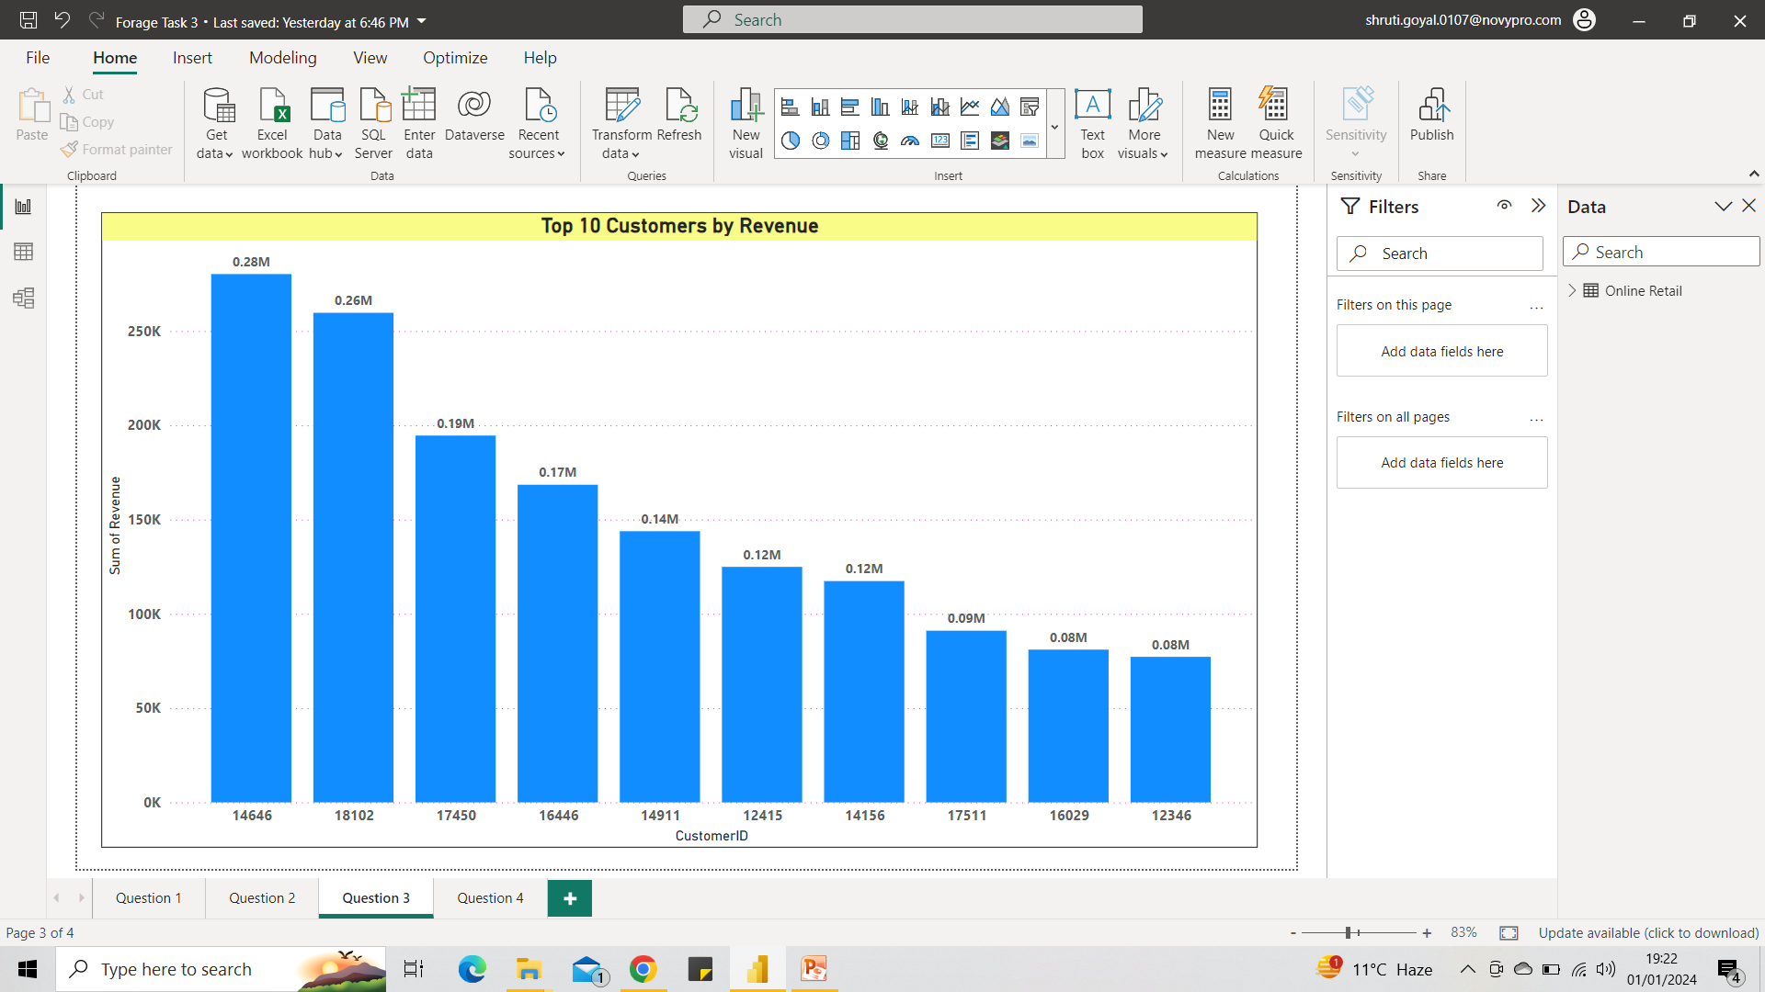
Question 3

Slide 12
Observations - Visual 3
Top customers which are highest Revenue provider for our Organization, which are precious to us.
Teams can track their purchasing habits
Teams can ask for their Positive feedback and it can be used as a great influence for other buyers.
Company can provide them good offers and sponsorship for marketing purpose.

Slide 13
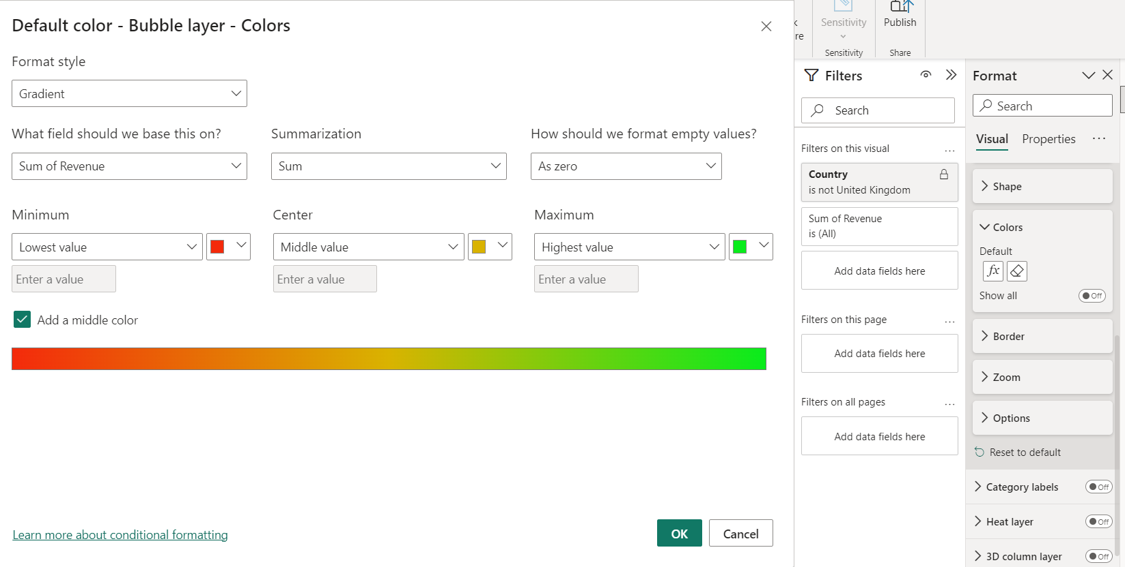
Question 4
Bubble colour is modified to Gradient according to Revenue

Slide 14
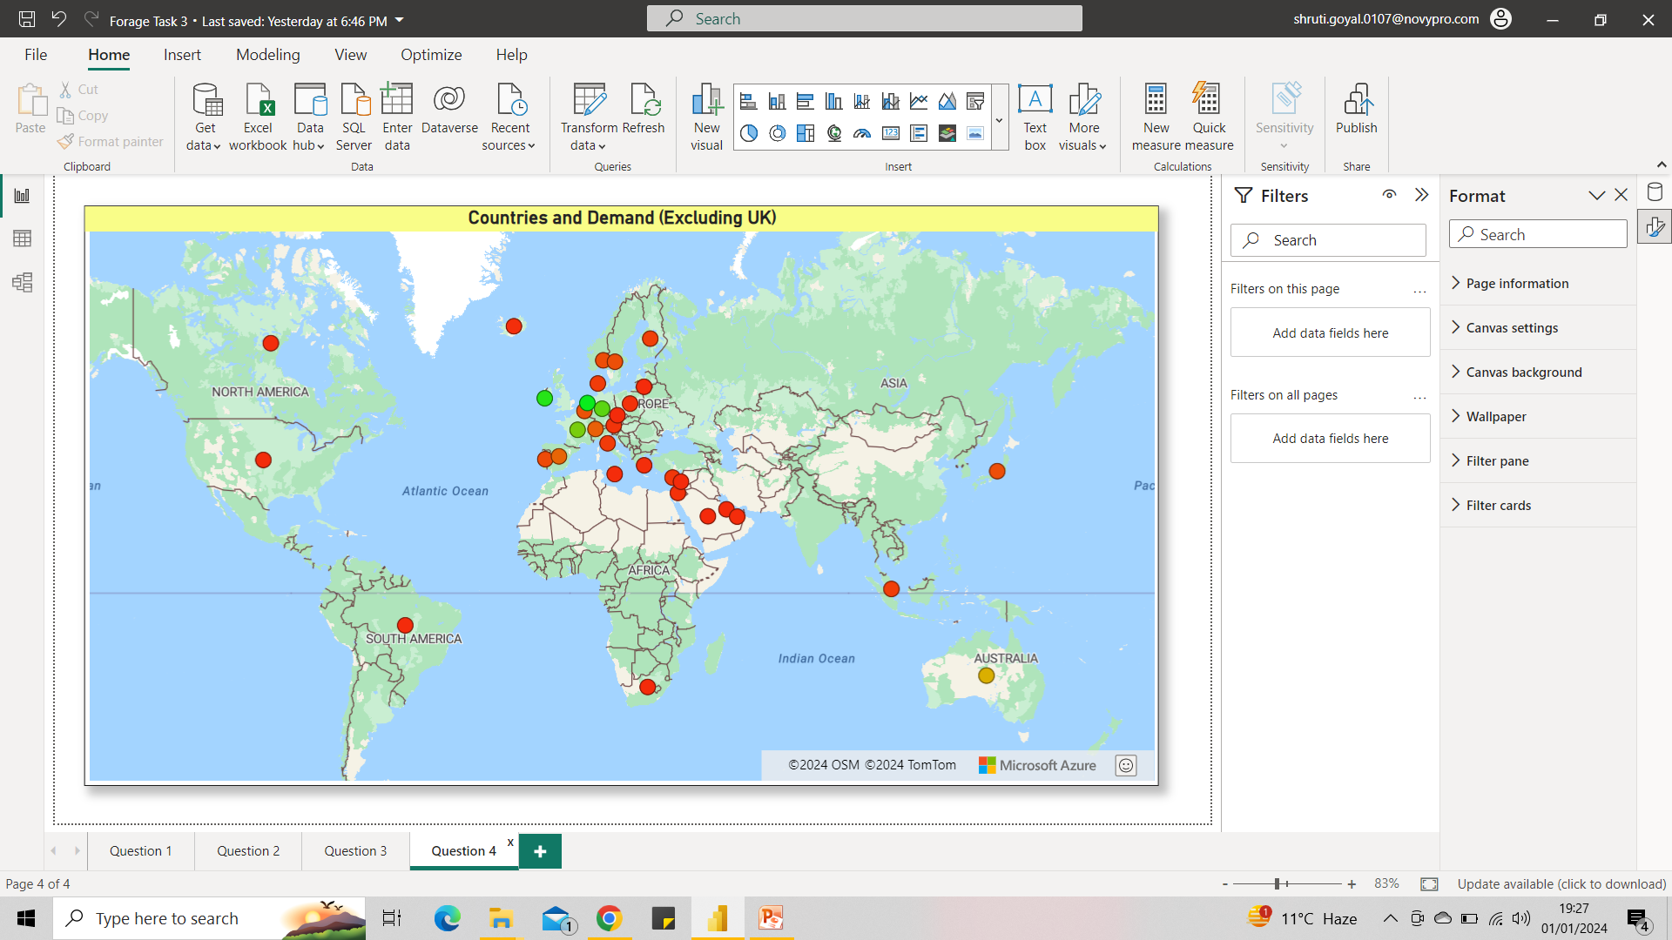
Question 4

Slide 15
Observations - Visual 4
As asked in question there is no need to Zoom /Hover or Click to observe the Comparative study of Revenue generation across the Countries.
Green- Highest, Yellow- Moderate and Red coloured countries are Lowest in Revenue Generation.
We can study suitable areas for further expansion for our organization.
Which continent needs highest and lowest efforts can also be tracked.

